Slide 1
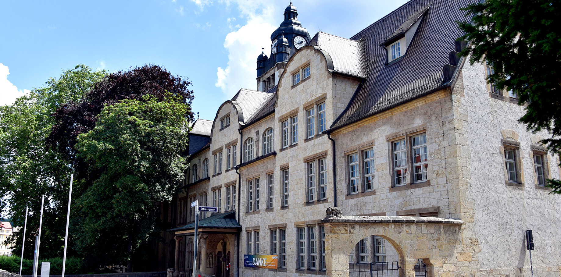
Camara enabled
Linear Encoder
Felix Fleisch, Bruno Reinhold AWP 3D Project
Foto: Anne Günther

Slide 2

Agenda
Motivation
Project Overview
Theoretical Concepts
Project Evaluation
Project Demonstration

Slide 3
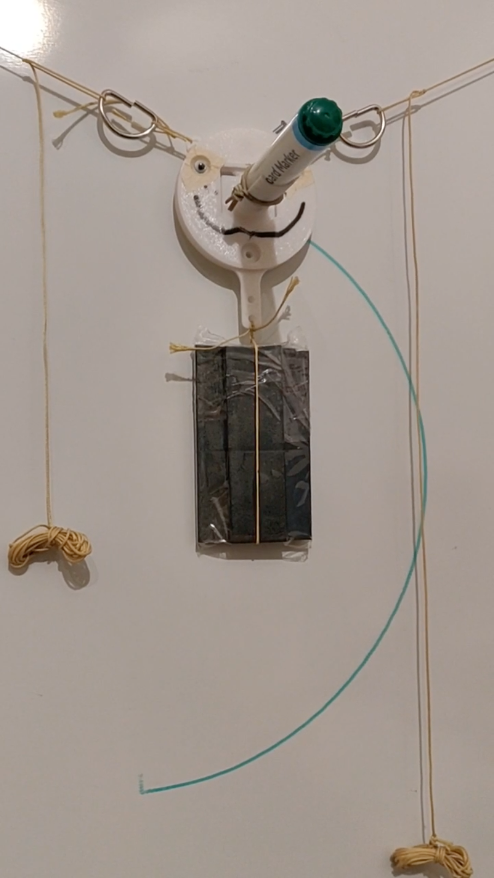
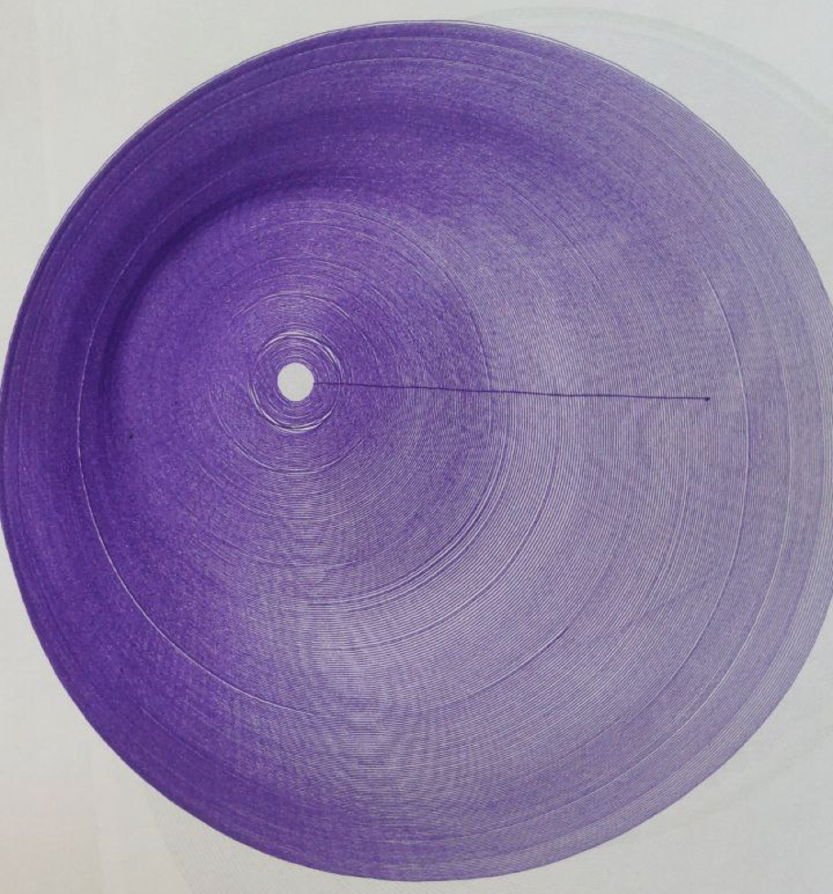
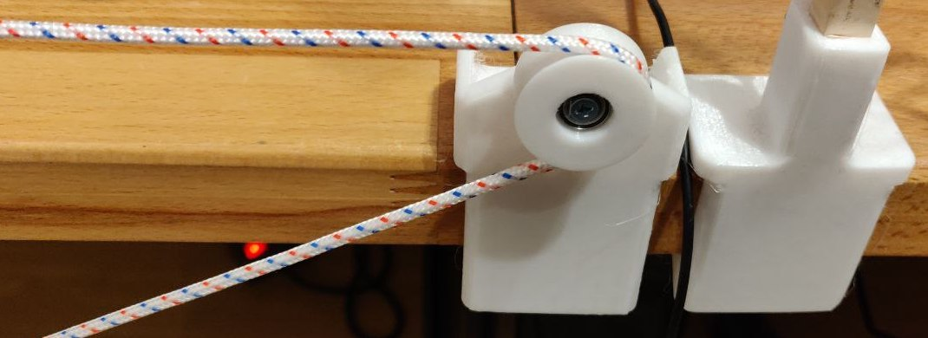
Motivation
idea:
-> develop linear encoder for 2D-plotter
problem:
-> ropes of the linear encoder slip over the pulley
-> small error builds up
-> the bigger the 2D-plotter gets the larger the error
solution:
-> encoding the movement of the rope to track the exact position
-> align assumed and actual position of the plotter head
Foto: Jan-Peter Kasper
Foto: Jan-Peter Kasper
Figure1: 2D-plotter head (top-left), erroneous plot (top-right), slipping pulley (bottom)

Slide 4
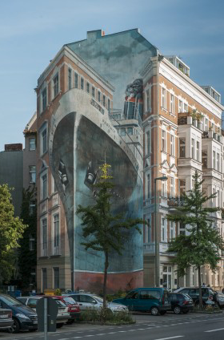
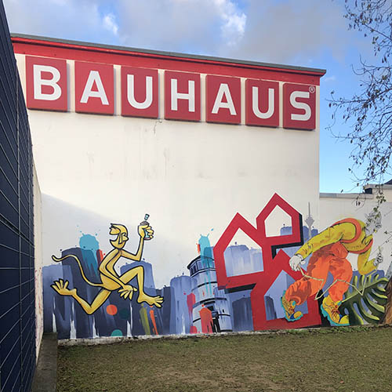
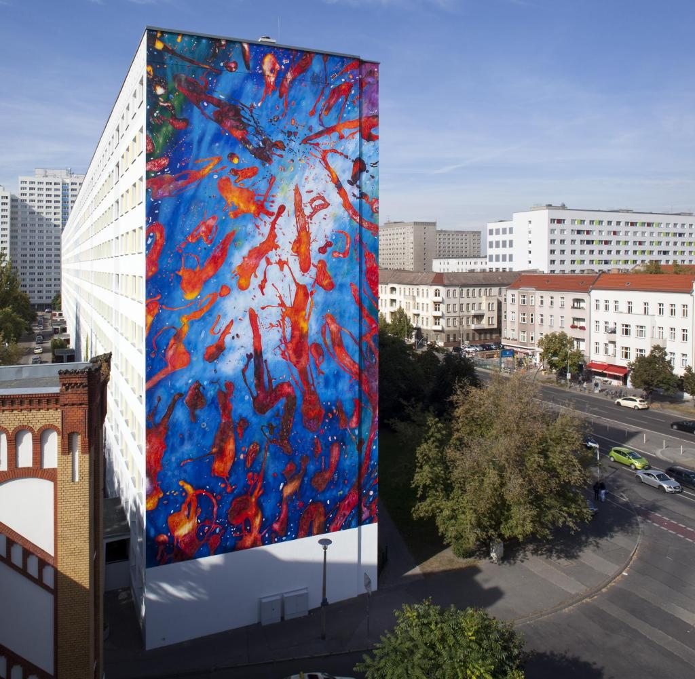
Motivation
vision:
-> linear encoder scalable to
large plotter systems
-> painting on residential and
commercial buildings
(advertisement)
-> CNC – machines utilizing
ropes
Foto: Jan-Peter Kasper
https://www.sueddeutsche.de/geld/wandbilder-alles-fassade-1.3613836#
https://www.orig-ami.de/wp-content/uploads/2021/01/Graffitiauftrag_Bauhaus_2020_thumbnail.jpg
https://img.welt.de/img/finanzen/immobilien/mobile128119005/1852505567-ci102l-w1024/WS-Finanzen-Fassadenkunst.jpg

Slide 5
Project Overview
Goal of the project:
-> build a camara enabled linear encoder
software
-> applicable to ropes and chains
Foto: Jan-Peter Kasper

Slide 6
Project Overview
Roadmap:
1) Build Testbed for recording test footage
2) Developing the linear encoder prototype
2.1) Identify region of interest
2.2) detect shift of rope or chain
3) Refactor the prototype into a software library

Slide 7
Theoretical Concepts
Limits of the Method
-> Nyquist-Shannon-Sampling Theorem
-> Encoding of rope possible up to certain speed
-> limited by framerate of camara
-> pattern on rope must be periodically

Slide 8
Theoretical Concepts
Identifying region of interest
-> Canny algorithm for edge detection
-> Hough lines through conjectured rope
-> rotation towards horizontal axis
-> cropped window around avg. Hough line

Slide 9
Theoretical Concepts
Canny algorithm
->

Slide 10
Theoretical Concepts
Hough lines
->

Slide 11
Theoretical Concepts
Encoding the rope:
-> determining the shift of the rope
-> correlating the pattern of the rope with ground
truth frame.
->

Slide 12
Project Evaluation
What works:
-> linear encoder is able to encode ropes
-> detecting slipping ropes
-> footage can have minor distractions
-> steady camera position required
-> good lighting conditions without changes

Slide 13
Project Evaluation
Future work:
-> resistance against axial rotating ropes
->

Slide 14
Demo
Name des Referenten, Funktion

